Slide 1
WE’RE NOT THAT FAR APART:
Transformational Ideas From
The Oregon Values & Beliefs Project
2014 Public Interest Environmental Law Conference
Tom Bowerman, Director PolicyInteractive www.policyinteractive.org
William McConochie, PhD www.politicalpsychologyresearch.com

Slide 2
EXPLORING OREGON VALUES 2013
(DHM PRIORS 1992, 2002)
Three surveys; spaced 2 weeks apart; 198 questions
Multiple Data Modes, Landline, Cell & Internet
S1: 3,971 respondents (1.6% MOE @ 95% confidence)
S2: 1,958 respondents (2.2% MOE @ 95% confidence)
S3: 1,865 respondents (2.3% MOE @ 95% confidence)
Oversampling for Geographic Representativeness
Statistical weighting for age, gender & income
Quality control: best practices for survey error & bias
Notes:
TIME CONSTRAINT DISCUSSION OF METHODS, A THE WEBSITE LINK WILL BE PROVIDED IN LIEU. ONLY TO MENTION THAT THESE RESULTS ARE STATISTICALLY REPRESENTATIVE OF OREGON AS WELL AS FIVE GEOGRAPHIC SECTORS. DATA CAME FROM 198 QUESTIONS ASKED WITHIN THREE SURVEYS SPACED TWO WEEKS APART IN 2013. THE QUSTIONS WERE ASKED ON TELEPHONE LANDLINES AND CELLS, AS WELL AS RANDOMLY DERIVED INTERNET ADDRESSES, IN PART OBTAINED THROUGH RECRUITING ON THE FIRST RANDOM DIAL SURVEY OF 4000.[NEXT]

Slide 3
Disclaimer
The opinions presented here are solely of the presenters and not those of the project sponsors.

Slide 4
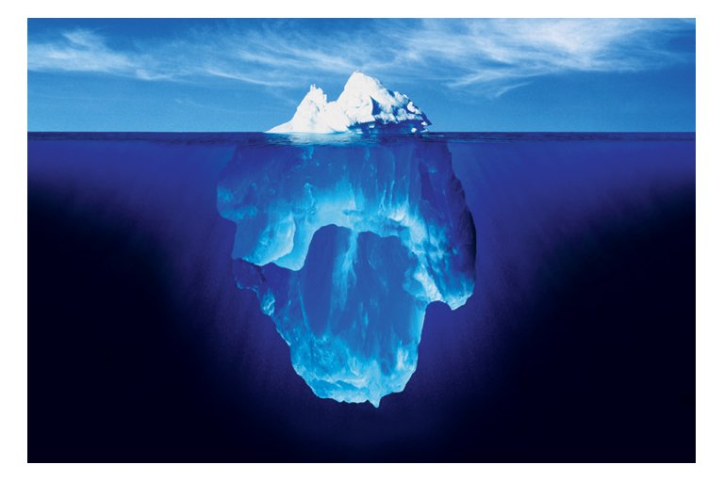

Slide 5
Variety of question styles used:
-Strength of Agreement matrix
-Probability/Desirability -Open ended response
-Forced Choice Question Style
Three examples of Forced Choice
Which statement do you agree with more even if neither represents your view exactly?
(Ordering randomized & A/B rotates)

Slide 6
Which statement comes closest to your view?
S1-Q28
Statement A:
Economic Growth should be given priority even if the environment suffers to some extent
Statement B:
Protection of the environment should be given priority even at the risk of slowing economic growth
Color Tone Key:
Light: Lean towards
Dark: Feel strongly
Notes:
FOR THE VIEWING AUDIENCE HERE, THE DARKER PORTION OF THE BAR GRAPHS REPRESENT “STRONGLY” AGREE OR DISAGREE WITH THE STATEMENT THEY CHOSE, THE LIGHTER IS “LEAN TOWARDS” THAT STATEMENT.
6

Slide 7
Which statement comes closest to your view?
(statements always rotate)
S1-Q27
Statement A:
Economic growth should be given priority even if the environment suffers to some extent
Statement B:
Protection of the environment should be given priority even
at the risk of slowing economic growth
Notes:
THE PROJECT USED A VARIETY OF QUESTION STYLES. THIS SHORT GROUP WE CALL “COMPETING WORLD VIEWS” WHERE RESPONDENT IS ASKED WHICH ONE OF TWO STATEMENTS REPRESNTS THEIR VIEW MORE CLOSELY, EVEN IF NOT EXACTLY, INCLUDLING A DON’T KNOW OPTION. THE STATEMENTS ROTATE SO HALF RESPONDENS SEE STATEMENT A FIRST AND HALF SEE STATEMENT B FIRST – THIS NEUTRALIZES INFLUENCE OF STATEMENT ORDERING. FOR OUR RADIO AUDIENCE I WILL READ THE STATEMENTS AND PROVIDE THE PERCENTAGES OF EACH.
7

Slide 8
Which statement comes closest to your view?
S1-Q32
Statement A:
Climate change requires us to change our way of life such as driving less or living more simply
Statement B:
If climate change becomes a problem we can deal with it later
Notes:
S1-Q32
8

Slide 9
Which statement comes closest to your view?
(statements always rotate)
S1-Q27
Statement A:
Climate change requires us to change our way of life such as driving less or living more simply.
Statement B:
If climate change becomes a problem, we can deal with it later.
Notes:
THE PROJECT USED A VARIETY OF QUESTION STYLES. THIS SHORT GROUP WE CALL “COMPETING WORLD VIEWS” WHERE RESPONDENT IS ASKED WHICH ONE OF TWO STATEMENTS REPRESNTS THEIR VIEW MORE CLOSELY, EVEN IF NOT EXACTLY, INCLUDLING A DON’T KNOW OPTION. THE STATEMENTS ROTATE SO HALF RESPONDENS SEE STATEMENT A FIRST AND HALF SEE STATEMENT B FIRST – THIS NEUTRALIZES INFLUENCE OF STATEMENT ORDERING. FOR OUR RADIO AUDIENCE I WILL READ THE STATEMENTS AND PROVIDE THE PERCENTAGES OF EACH.
9

Slide 10
17 (How desirable or undesirable; with $$ and $ cost implications)
A carbon emission tax established to discourage greenhouse gas emissions and used to invest in green jobs and technologies
S3-Q48
50%
26%
Notes:
S3-Q44
10

Slide 11
S3-47
(How much Agree – Disagree with:)
Science and human ingenuity will solve climate change with little need to change our way of life
61%
19%
Notes:
S2-50
11

Slide 12
Which statement comes closest to your view?
S1-Q28
Statement A:
We should invest more in roads for cars
Statement B:
We should invest more in public transit
Tone Key:
Light: Lean towards
Dark: Feel strongly
Notes:
FOR THE VIEWING AUDIENCE HERE, THE DARKER PORTION OF THE BAR GRAPHS REPRESENT “STRONGLY” AGREE OR DISAGREE WITH THE STATEMENT THEY CHOSE, THE LIGHTER IS “LEAN TOWARDS” THAT STATEMENT.
12

Slide 13
Which statement comes closest to your view?
(statements always rotate)
S1-Q27
Statement A:
We should invest more in roads for cars
Statement B:
We should invest more in public transit
Notes:
THE PROJECT USED A VARIETY OF QUESTION STYLES. THIS SHORT GROUP WE CALL “COMPETING WORLD VIEWS” WHERE RESPONDENT IS ASKED WHICH ONE OF TWO STATEMENTS REPRESNTS THEIR VIEW MORE CLOSELY, EVEN IF NOT EXACTLY, INCLUDLING A DON’T KNOW OPTION. THE STATEMENTS ROTATE SO HALF RESPONDENS SEE STATEMENT A FIRST AND HALF SEE STATEMENT B FIRST – THIS NEUTRALIZES INFLUENCE OF STATEMENT ORDERING. FOR OUR RADIO AUDIENCE I WILL READ THE STATEMENTS AND PROVIDE THE PERCENTAGES OF EACH.
13

Slide 14
S2-50
Shift some funding for road and highway construction towards public transportation such as better bus service and high speed rail projects
47%
27%
Notes:
S2-50
14

Slide 15
(How desirable or undesirable; with $$ & $ cost implications)
Increase investments in public transportation
S3-Q50
56%
17%
Notes:
OVER 3:1
15

Slide 16
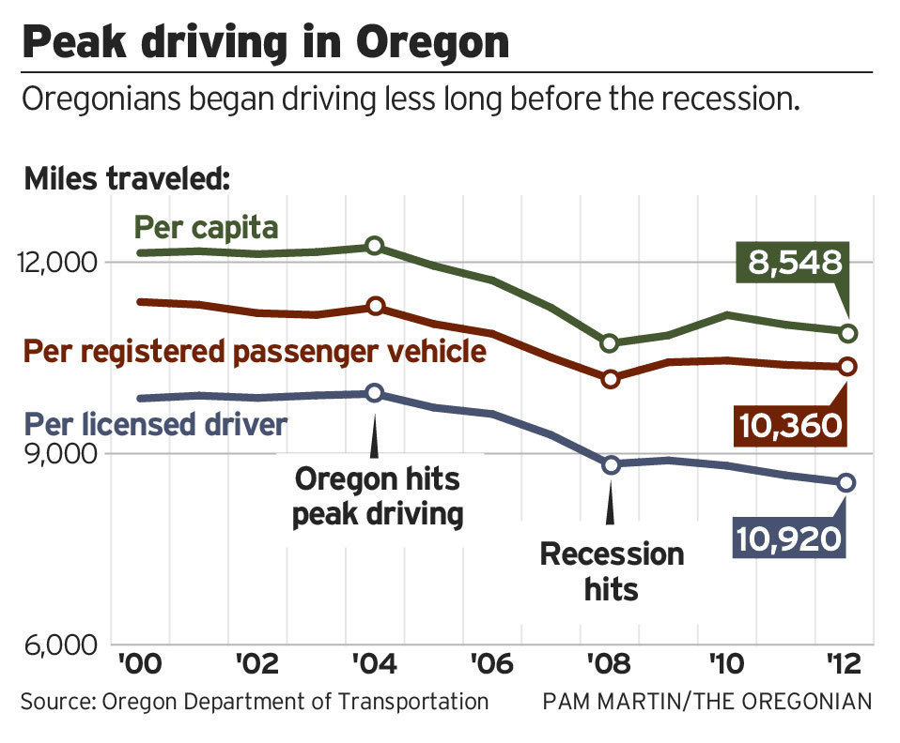
10,920
8,548

Slide 17
S3-Q46
(How desirable or undesirable?)
There should be stronger government policies to reduce greenhouse gas emissions
57%
22%
Notes:
S3-Q44
17

Slide 18
S2-17
Economic growth will be more important than addressing climate change
59%
37%
40%
19%
Notes:
S2-17
18

Slide 19
Which statement comes closest to your view?
S1-Q31
Statement A: Our country would be better off if we all consumed less
Statement B: We need to buy things to support a strong economy
Notes:
S1-Q31
19

Slide 21
Political Party Ideology Comparison
Compare - Global Warming : Consume less
PI November 2008 n=400 V4A/V1A (% Combined Agreement of Sector)

Slide 22
With roughly two-thirds of consumers saying they care, why is ethical consumption so minimal and so rarely transformative?
- Dana O’Rourke, book review of Market for Virtue by David Vogle

Slide 23

ATTITUDE A
X
BEHAVIOR B
Notes:
Sharing our results with other researchers frequently results in a discussion of the Attitude – Behavior Gap, a well established human phenomenon. While we have shown a strong attitudinal disposition “to consume less”, we are mostly aware that there are profound barriers for most of us to make dramatic reductions in our habituated behaviors. Our social conformity drives, how measure our own sense of worth and identity, the sheer inertia of the river we are swimming in and the physical constraints of our social infrastructure all conspire to restrain us from wholesale redirection of our affluent consumption behavior. We have been interviewing numbers of people who have voluntarily downshifted this past year, coupled with a similar group who express the consume less attitude but remain high affluent consumers. We are especially interested in the how the theory of cognitive dissonance may impart insights toward motivation or paralysis of action. Thus far I’d report this to be a challenging and yet to be fruitful component. I hope this discussion component gives a good set-up for our next speaker.

Slide 24
ATTITUDE A
X
BEHAVIOR B
Notes:
Sharing our results with other researchers frequently results in a discussion of the Attitude – Behavior Gap, a well established human phenomenon. While we have shown a strong attitudinal disposition “to consume less”, we are mostly aware that there are profound barriers for most of us to make dramatic reductions in our habituated behaviors. Our social conformity drives, how measure our own sense of worth and identity, the sheer inertia of the river we are swimming in and the physical constraints of our social infrastructure all conspire to restrain us from wholesale redirection of our affluent consumption behavior. We have been interviewing numbers of people who have voluntarily downshifted this past year, coupled with a similar group who express the consume less attitude but remain high affluent consumers. We are especially interested in the how the theory of cognitive dissonance may impart insights toward motivation or paralysis of action. Thus far I’d report this to be a challenging and yet to be fruitful component. I hope this discussion component gives a good set-up for our next speaker.

Slide 25
ATTITUDE A
X
BEHAVIOR B
Notes:
Sharing our results with other researchers frequently results in a discussion of the Attitude – Behavior Gap, a well established human phenomenon. While we have shown a strong attitudinal disposition “to consume less”, we are mostly aware that there are profound barriers for most of us to make dramatic reductions in our habituated behaviors. Our social conformity drives, how measure our own sense of worth and identity, the sheer inertia of the river we are swimming in and the physical constraints of our social infrastructure all conspire to restrain us from wholesale redirection of our affluent consumption behavior. We have been interviewing numbers of people who have voluntarily downshifted this past year, coupled with a similar group who express the consume less attitude but remain high affluent consumers. We are especially interested in the how the theory of cognitive dissonance may impart insights toward motivation or paralysis of action. Thus far I’d report this to be a challenging and yet to be fruitful component. I hope this discussion component gives a good set-up for our next speaker.

Slide 26
DISSONANCE
  Anxiety
  Grief
  Avoidance
  Denial
ATTITUDE A
X
CONSTRAINTS
Habits
Norms (conformity)
Self identity
Ideology (social)
Desires
Physical constraints
BEHAVIOR B
Notes:
Sharing our results with other researchers frequently results in a discussion of the Attitude – Behavior Gap, a well established human phenomenon. While we have shown a strong attitudinal disposition “to consume less”, we are mostly aware that there are profound barriers for most of us to make dramatic reductions in our habituated behaviors. Our social conformity drives, how measure our own sense of worth and identity, the sheer inertia of the river we are swimming in and the physical constraints of our social infrastructure all conspire to restrain us from wholesale redirection of our affluent consumption behavior. We have been interviewing numbers of people who have voluntarily downshifted this past year, coupled with a similar group who express the consume less attitude but remain high affluent consumers. We are especially interested in the how the theory of cognitive dissonance may impart insights toward motivation or paralysis of action. Thus far I’d report this to be a challenging and yet to be fruitful component. I hope this discussion component gives a good set-up for our next speaker.

Slide 27
How Social Does Change Happen?
PUBLIC POLICY or INDIVIDUAL BEHAVIOR?
DOES INDIVIDUAL BEHAVIOR COUNT?
MOTIVATIONS:
Materialism or Well-being?

Slide 28
“It is naive to ask consumers to voluntarily downscale, and give up their desires without offering them alternative dreams.”
Tim Jackson, Sustainable Development Commission, U.K.

Slide 29
Income/Emissions/Life Satisfaction
Four Nations & Oregon Compared
Oregon Source Data:
Income: Oregon Blue Book
Emissions US DOE & DataMasher
Satisfaction: Gallup world survey template & PI Dec.09 survey (moe 403)
Income: Per Capita World Bank 2008 estimate (Atlas Method)
Emissions: Tons CO2/capita World Resources Institute (Source:Nationmaster)
Life Satisfaction:: Life Satisfaction Index Gallup World Survey 2008 (Source: Happiness Foundation)

Slide 30
Tons CO2 Emissions Per Capita Compared
Emissions: Tons CO2/capita World Resources Institute (Source:Nationmaster)
Sustainable estimate range, multiple sources: PI citations on file

Slide 31
DISSONANCE
  Anxiety
  Grief
  Avoidance
  Denial
ATTITUDE A
X
CONSTRAINTS
Habits
Norms (conformity)
Self identity
Ideology (social)
Desires
Physical constraints
BEHAVIOR B
Notes:
Sharing our results with other researchers frequently results in a discussion of the Attitude – Behavior Gap, a well established human phenomenon. While we have shown a strong attitudinal disposition “to consume less”, we are mostly aware that there are profound barriers for most of us to make dramatic reductions in our habituated behaviors. Our social conformity drives, how measure our own sense of worth and identity, the sheer inertia of the river we are swimming in and the physical constraints of our social infrastructure all conspire to restrain us from wholesale redirection of our affluent consumption behavior. We have been interviewing numbers of people who have voluntarily downshifted this past year, coupled with a similar group who express the consume less attitude but remain high affluent consumers. We are especially interested in the how the theory of cognitive dissonance may impart insights toward motivation or paralysis of action. Thus far I’d report this to be a challenging and yet to be fruitful component. I hope this discussion component gives a good set-up for our next speaker.

Slide 32
Actionables:
Personal Behaviors
Know your own actions: “Oregon Carbon Calculator”
Mindfulness! Thoughtful consumption
Car & Commute
House Size & Operation
Airplane travel
Transformational – Incremental?
Group Decision-making …
Dr. William McCononchie, Licensed Psychologist and Director of Political Psychology Research, Inc.

Slide 33
S3-Q21
Oregonians from diverse backgrounds will find common ground and work together to make progress addressing the critical issues we face as a state
Combined Very/Somewhat Responses
Notes:
S3-Q21
33

Slide 34
Psychological Dimensions of
Climate Change Politics
William McConochie, Ph.D.
Psychologist

Slide 35
Expertise:
Ph.D., Post-doc, Stanford SIPP.
Clinical and applied. Private practice.
Build and market batteries of tests for screening job applicants.
11 years of research in political psychology.
Political Psychology Research, Inc.
Member APA, International Society of Political Psychology.

Slide 36
Approaches to climate issues:
Legal: Essentially unsuccessful according to James Gus Speth, professor of law, U. of Vermont.
Traditional political: Unsuccessful to date, as fossil fuel industries control government policies. 86%...
2/3 of citizens worldwide care about environment…but lack political power .

Slide 37
How can the citizen gain political power?
Perhaps via the science of psychology…
Especially as revealed by questionnaire studies of citizen attitudes.
Such as Tom Bowerman, Adam Davis and I have done.

Slide 38
Attitudes can be measured very reliably and validly with agree-disagree statements:
1. Strongly disagree
2. Disagree
3. Neither, or between 2 and 4.
4. Agree.
5. Strongly agree.

Slide 39
Sample questionnaire items:
Warmongering endorsement:
“My government should do what best serves our nation’s interests, at the expense of other nations, enforced by military action if necessary.”
“It is more honorable to serve one’s nation as a warrior in combat than as an anti-war protester.”
Human rights endorsement:
“Slavery is wrong.”

Slide 40
More attitude sample items:
Fundamentalism: “There is only one true God.”
Kindly religion: “God can be well-defined simply as the universal spirit of human goodness and kindness.”
Share economics: “Rich people should pay more in taxes than poor people.”
Gender attitudes: “Women deserve pay equal to men for the same job.”
Environment: “Our national government should promote replacement of fossil fuels with non-polluting fuels.”

Slide 41
Examples of traits measured:
Political orientation…liberal, conservative, independent.
Fundamentalist religious beliefs.
Kindly religious beliefs.
Gender attitudes.
Economic policy.
Peaceful foreign policy.
Preferred types of government.

Slide 42
My primary findings:
Political attitudes fall into two clusters, liberal and conservative.
Liberal and conservative worldviews are mainly inherited.
Conservatism is oriented toward protecting in-groups.
Liberalism is oriented toward cooperation with neighbors.

Slide 43
More highlights:
About 1/6 of U.S. citizens self-identify as liberals, 1/6 conservative, 2/3 in between.
Only about 20 percent endorse government serving citizens as members of special interest groups.
90% endorse government that serves them as members of the community overall.

Slide 44
Strong liberals and conservatives, as groups, are rather close together on most general political attitudes, e.g…
They tend to endorse:
Peaceful foreign policy,
Gender equality,
Common good democracy,
Share economics,
Concern for the environment.

Slide 45
My study samples have included:
Eugene business executives, church members, community college students, university students, international students, 1st generation immigrants from Slavic Europe, students in New York and Florida.
GSS (General Social Survey data). Random samples of U.S. citizens, different years.
Most recently, a random sample of 1200 Oregonians via Tom Bowerman and Adam Davis of local polling companies.

Slide 46
Highlights of Oregon data:
Liberalism… more supportive of …
Public transportation
Public education
Protection of air and water quality.
Publicly funded health insurance for all.
Energy efficiency programs, promoting conservation.
Renewable energy incentives and investments.
Changing our ways due to climate change.

Slide 47
Conservatives more supportive of…
Public safety, fire and police services.
Economic development via subsidies and tax breaks to companies that produce jobs.
Locking up criminals, vs. rehabilitation.
Economic growth stimulus vs. protecting environment.

Slide 48
Percent of sample endorsing…
76% Public safety, fire and police services.
80 K-12 Education programs.
73 Protecting air and water quality.
56 Energy efficiency programs.
62 Healthy behavior rewards.
65 Protection of farm and forest from other development.
29% Criminals should be locked up vs. rehabilitation.
35 Economic growth stimuli vs. environment protect.

Slide 49
Mean scores of strong liberals and strong conservatives:
Issue | Endorse |  | Neutral | Not endorse
Public safety |  | 2.1L 2.4C
Prot. Air/h2o | 1.4 L | 2.8C
Pub Health Insurance | 2.0L |  |  | 4.0C
Public infrastruc. |  | 2.0L 2.3C
Protect farm/forest | 1.7L |  | 3.0C
Climate/ change our ways | 1.2 L 1.8ALL | 2.8C

Slide 50
How policy makers and individuals can use this information:
Policy makers (governments). Use sophisticated, reliable public polls to help define government policy.
Individuals . Form a new type of political party that will give them greater political power.

Slide 51
New type of political party:
Unite both liberals and conservatives.
Use mean scores on polls of public and party members to define platform, policy agenda.
Groom party members for elective office.
Require candidate devotion to party agenda.
Fund candidate campaigns only from party member dues.

Slide 52
Papers for details are:
On my web site, Politicalpsychologyresearch.
com.
E.g. Publications #32, 39 & 41.

Slide 53
Book: “Party Time! How you can enjoy creating common good democracy, right now.
Self-publish in paperback and electronic.
Via Amazon.
Soon.
Bill McConochie
Bill at Politicalpsychologyresearch.com.
Ph 541-686-9934

