Slide 1
THE CHALLENGE
Planetary Stability for
Eugene City Club
May 2, 2014
Tom Bowerman
PolicyInteractive Research www.policyinteractive.org

Slide 2
Some findings draw from Oregon Values & Beliefs Project
2
  -198 Questions using three surveys spaced 2 weeks apart
  -Diverse range of topics: Economy, Education, Healthcare, Environment, Public Safety, Transportation, etc.
  This presentation of findings, observations and conclusions reflects the judgment of this presenter and not necessarily the views of the sponsoring organizations.

Slide 3
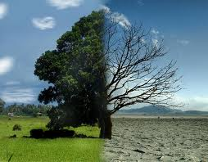
IS GLOBAL WARMING A HOAX?

Slide 4
HERE ARE SOME STATEMENTS PEOPLE MAKE ABOUT CLIMATE CHANGE.
INDICATE YOUR LEVEL OF AGREEMENT OR DISAGREEMENT FOREACH STATEMENT.
75%
15%
71%
16%
78%

Slide 5
World-view Items
Using A/B Forced-choice Style:
Which statement do you agree with more even if neither represents your view exactly?
(Ordering randomized & A/B item rotates)

Slide 6
Which statement comes closest to your view?
S1-Q32 n=2971
Statement A:
Climate change requires us to change our way of life such as driving less or living more simply
Statement B:
If climate change becomes a problem we can deal with it later
Notes:
S1-Q32
6

Slide 7
7
Which statement comes closest to your view?
(statements always rotate)
S1-Q32
Statement A:
Climate change requires us to change our way of life such as driving less or living more simply.
Statement B:
If climate change becomes a problem, we can deal with it later.
Notes:
THE PROJECT USED A VARIETY OF QUESTION STYLES. THIS SHORT GROUP WE CALL “COMPETING WORLD VIEWS” WHERE RESPONDENT IS ASKED WHICH ONE OF TWO STATEMENTS REPRESNTS THEIR VIEW MORE CLOSELY, EVEN IF NOT EXACTLY, INCLUDLING A DON’T KNOW OPTION. THE STATEMENTS ROTATE SO HALF RESPONDENS SEE STATEMENT A FIRST AND HALF SEE STATEMENT B FIRST – THIS NEUTRALIZES INFLUENCE OF STATEMENT ORDERING. FOR OUR RADIO AUDIENCE I WILL READ THE STATEMENTS AND PROVIDE THE PERCENTAGES OF EACH.
7

Slide 8
Which statement comes closest to your view?
S1-Q28 n=2971
Statement A:
We should invest more in roads for cars
Statement B:
We should invest more in public transit
Tone Key:
Light: Lean towards
Dark: Feel strongly
Notes:
FOR THE VIEWING AUDIENCE HERE, THE DARKER PORTION OF THE BAR GRAPHS REPRESENT “STRONGLY” AGREE OR DISAGREE WITH THE STATEMENT THEY CHOSE, THE LIGHTER IS “LEAN TOWARDS” THAT STATEMENT.
8

Slide 9
Which statement comes closest to your view?
(statements always rotate)
S1-Q27
Statement A:
We should invest more in roads for cars
Statement B:
We should invest more in public transit
Notes:
THE PROJECT USED A VARIETY OF QUESTION STYLES. THIS SHORT GROUP WE CALL “COMPETING WORLD VIEWS” WHERE RESPONDENT IS ASKED WHICH ONE OF TWO STATEMENTS REPRESNTS THEIR VIEW MORE CLOSELY, EVEN IF NOT EXACTLY, INCLUDLING A DON’T KNOW OPTION. THE STATEMENTS ROTATE SO HALF RESPONDENS SEE STATEMENT A FIRST AND HALF SEE STATEMENT B FIRST – THIS NEUTRALIZES INFLUENCE OF STATEMENT ORDERING. FOR OUR RADIO AUDIENCE I WILL READ THE STATEMENTS AND PROVIDE THE PERCENTAGES OF EACH.
9

Slide 10
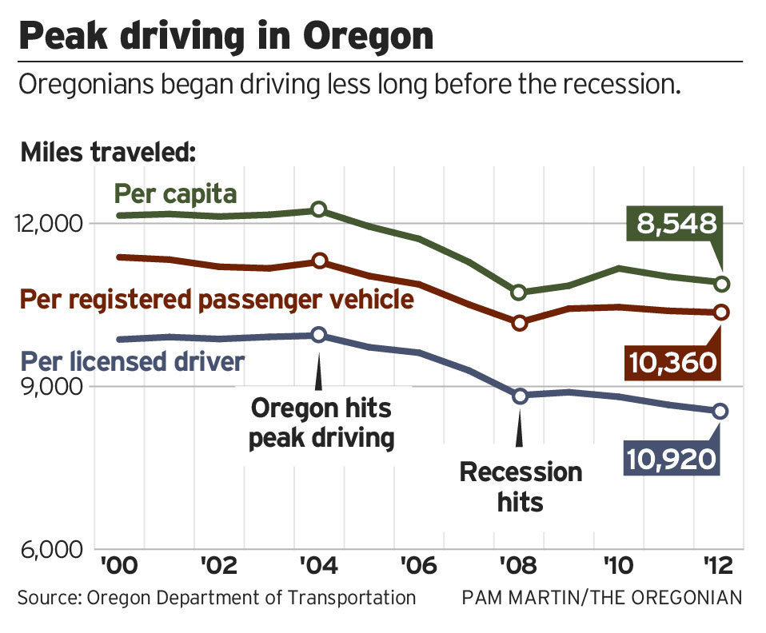

Slide 11
S2-17
Economic growth will be more important than addressing climate change
59%
37%
40%
19%
Notes:
S2-17
11

Slide 12
S3-Q46
(How desirable or undesirable?)
There should be stronger government policies to reduce greenhouse gas emissions
57%
22%
Notes:
S3-Q44
12

Slide 13
(How desirable or undesirable; with $$ and $ cost implications)
A carbon emission tax established to discourage greenhouse gas emissions and used to invest in green jobs and technologies
S3-Q48
50%
26%
Notes:
S3-Q44
13

Slide 14
S3-47
(How much Agree – Disagree with:)
Science and human ingenuity will solve climate change with little need to change our way of life
61%
19%
Notes:
S2-50
14

Slide 15
Impact =
Population x Affluence x Technology
IPAT

Slide 17
Political Party Ideology Comparison
Compare - Global Warming : Consume less
PI November 2008 n=400 V4A/V1A (% Combined Agreement of Sector)

Slide 18
Cultural Ideology Comparison
Christian Conservative & Environmentalist
Compare Global Warming / Consume less
PI November 2008 n=400 V4A/V1A (expressed as % Agreement of Sector)

Slide 19
With roughly two-thirds of consumers saying they care, why is ethical consumption so minimal and so rarely transformative?
- Dana O’Rourke, book review of Market for Virtue by David Vogle

Slide 20

ATTITUDE A
X
BEHAVIOR B
Notes:
Sharing our results with other researchers frequently results in a discussion of the Attitude – Behavior Gap, a well established human phenomenon. While we have shown a strong attitudinal disposition “to consume less”, we are mostly aware that there are profound barriers for most of us to make dramatic reductions in our habituated behaviors. Our social conformity drives, how measure our own sense of worth and identity, the sheer inertia of the river we are swimming in and the physical constraints of our social infrastructure all conspire to restrain us from wholesale redirection of our affluent consumption behavior. We have been interviewing numbers of people who have voluntarily downshifted this past year, coupled with a similar group who express the consume less attitude but remain high affluent consumers. We are especially interested in the how the theory of cognitive dissonance may impart insights toward motivation or paralysis of action. Thus far I’d report this to be a challenging and yet to be fruitful component. I hope this discussion component gives a good set-up for our next speaker.

Slide 21
ATTITUDE A
X
BEHAVIOR B
Notes:
Sharing our results with other researchers frequently results in a discussion of the Attitude – Behavior Gap, a well established human phenomenon. While we have shown a strong attitudinal disposition “to consume less”, we are mostly aware that there are profound barriers for most of us to make dramatic reductions in our habituated behaviors. Our social conformity drives, how measure our own sense of worth and identity, the sheer inertia of the river we are swimming in and the physical constraints of our social infrastructure all conspire to restrain us from wholesale redirection of our affluent consumption behavior. We have been interviewing numbers of people who have voluntarily downshifted this past year, coupled with a similar group who express the consume less attitude but remain high affluent consumers. We are especially interested in the how the theory of cognitive dissonance may impart insights toward motivation or paralysis of action. Thus far I’d report this to be a challenging and yet to be fruitful component. I hope this discussion component gives a good set-up for our next speaker.

Slide 22
ATTITUDE A
X
BEHAVIOR B
Notes:
Sharing our results with other researchers frequently results in a discussion of the Attitude – Behavior Gap, a well established human phenomenon. While we have shown a strong attitudinal disposition “to consume less”, we are mostly aware that there are profound barriers for most of us to make dramatic reductions in our habituated behaviors. Our social conformity drives, how measure our own sense of worth and identity, the sheer inertia of the river we are swimming in and the physical constraints of our social infrastructure all conspire to restrain us from wholesale redirection of our affluent consumption behavior. We have been interviewing numbers of people who have voluntarily downshifted this past year, coupled with a similar group who express the consume less attitude but remain high affluent consumers. We are especially interested in the how the theory of cognitive dissonance may impart insights toward motivation or paralysis of action. Thus far I’d report this to be a challenging and yet to be fruitful component. I hope this discussion component gives a good set-up for our next speaker.

Slide 23
DISSONANCE
  Anxiety
  Grief
  Avoidance
  Denial
ATTITUDE A
X
CONSTRAINTS
Habits
Norms (conformity)
Self identity
Ideology (social)
Desires
Physical constraints
BEHAVIOR B
Notes:
Sharing our results with other researchers frequently results in a discussion of the Attitude – Behavior Gap, a well established human phenomenon. While we have shown a strong attitudinal disposition “to consume less”, we are mostly aware that there are profound barriers for most of us to make dramatic reductions in our habituated behaviors. Our social conformity drives, how measure our own sense of worth and identity, the sheer inertia of the river we are swimming in and the physical constraints of our social infrastructure all conspire to restrain us from wholesale redirection of our affluent consumption behavior. We have been interviewing numbers of people who have voluntarily downshifted this past year, coupled with a similar group who express the consume less attitude but remain high affluent consumers. We are especially interested in the how the theory of cognitive dissonance may impart insights toward motivation or paralysis of action. Thus far I’d report this to be a challenging and yet to be fruitful component. I hope this discussion component gives a good set-up for our next speaker.

Slide 24
“It is naive to ask consumers to voluntarily downscale, and give up their desires without offering them alternative dreams.”
Tim Jackson, Sustainable Development Commission, U.K.

Slide 25
One Measure of “hopes and dreams”: Life Satisfaction
24
All things considered, how satisfied are you with your life nowadays, with 1 being not satisfied at all and 10 being completely satisfied?
(annual Gallup World Survey and many others, normally on 1-10 scale)

Slide 26
Income/Emissions/Life Satisfaction Nation (normalized) & Oregon Compared
25
Income: Per Capita/Yr. World Bank 2013 estimate (Atlas Method)
Emissions: Tons CO2/capita EPA 2013 estimate
Life Satisfaction Index Gallup World Survey 2008 (Source: Happiness Foundation) PI 2008

Slide 27
Tons CO2 Emissions per Capita per Year Compared
Emissions: Tons CO2/capita World Resources Institute (Source:Nationmaster)
Sustainable estimate range, multiple sources: PI citations on file
Import – Export Emissions: https://carnegiescience.edu/news/carbon_emissions_outsourced_developing_countries

Slide 28
Tons CO2 Emissions per Capita per Year Compared – Consumption Based
19.7 t
with imports
5.2 t
w.o
exports
Emissions: Tons CO2/capita World Resources Institute (Source:Nationmaster)
Sustainable estimate range, multiple sources: PI citations on file
Import – Export Emissions: https://carnegiescience.edu/news/carbon_emissions_outsourced_developing_countries

Slide 29
Income/Emissions/Life Satisfaction
Four Nations & Oregon Compared
Income: Per Capita World Bank 2013estimate (Atlas Method), Oregon: US Bureau of Economic Analysis
Emissions: Tons CO2/capita 2012 World Bank & EPA for Oregon
Life Satisfaction:: Life Satisfaction Index Gallup World Survey 2008 (Source: Happiness Foundation); Oregon PI Dec 09

Slide 30
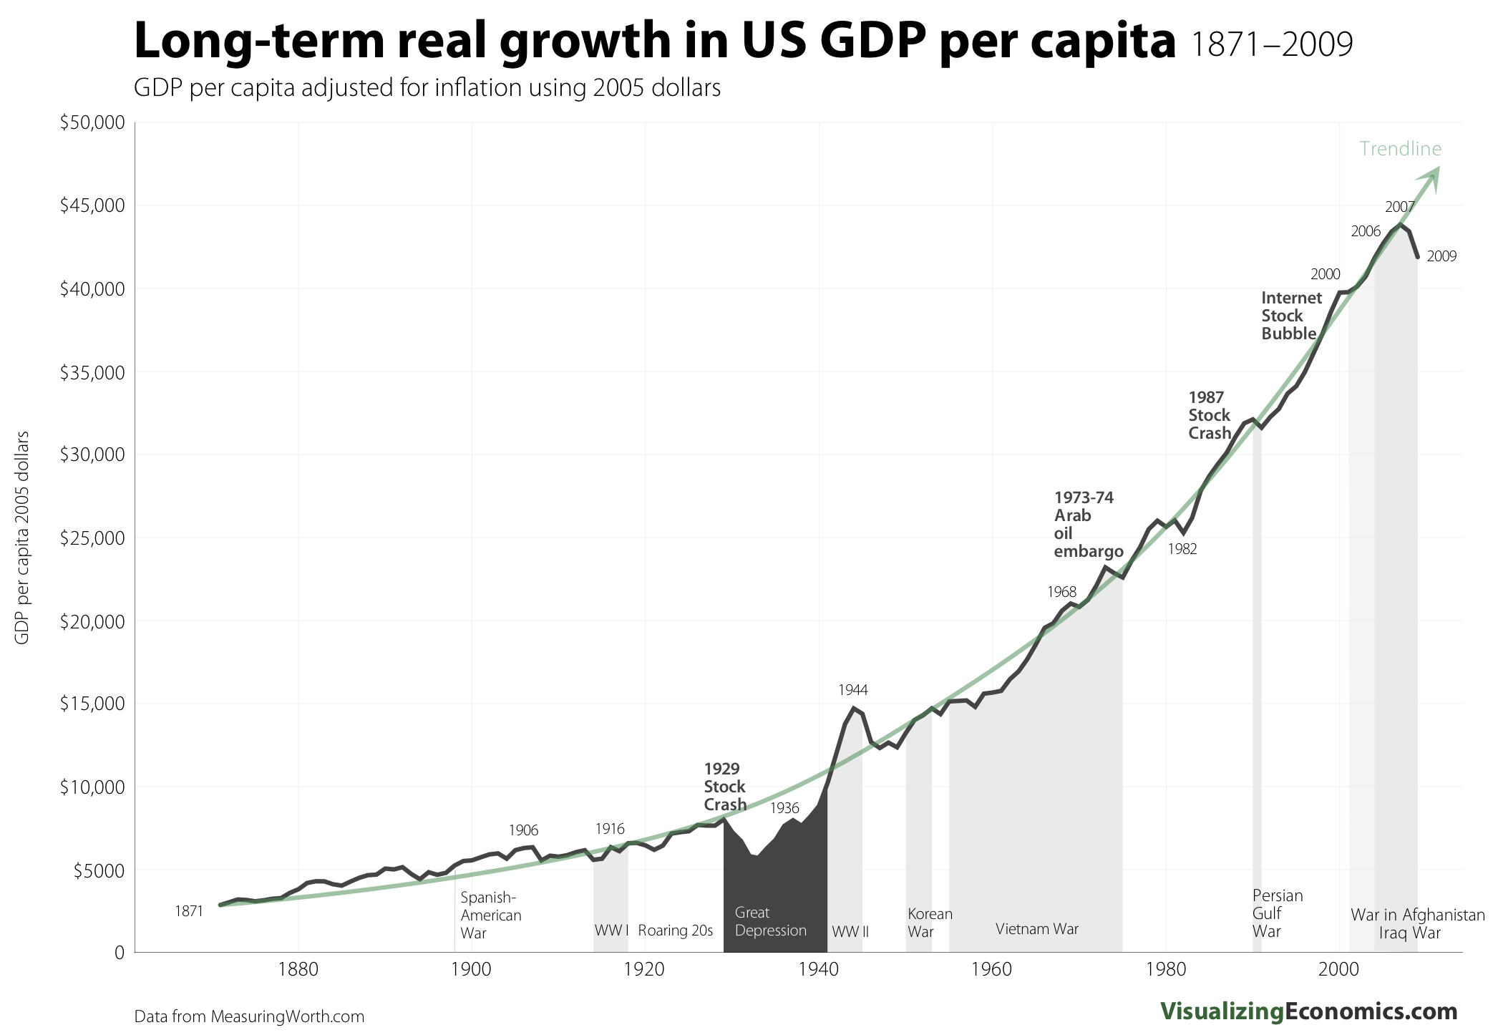
29
USA NOW
COSTA RICA NOW
Notes:
Putting this last graph of GDP into perspective, considering Costa Rica’s higher well-being compared to the US, the relative (inflation adjusted) position in GDP relative to where we were in a chronology of time is perhaps useful. I am old enough to still have relative who lived through the 1920’s, the relative position in wealth of Costa Rica today. My uncle was not from a wealthy family, but he tells me it was not a time of perceived suffering.

Slide 31
Thinking it through:
29
Push for Policy
Live simply by being thoughtful, using less
  Less money (correlation money = emissions)
  Less house
  Less travel (air travel emits carbon)
Know your emissions: “Oregon Carbon Calculator”
Think Globally, act locally
  World citizenship
  Community self reliance (&sharing economy)

Slide 32
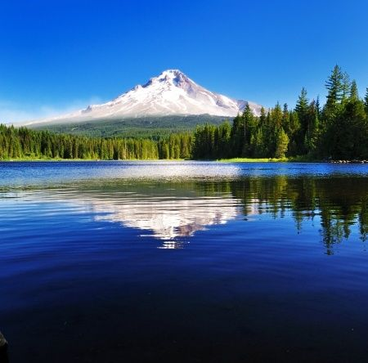

Slide 33
Appendices:
Message Frame Testing
OVB Public Policy Issues

Slide 34
Appendix 1: Message Frame Testing
City of Eugene Sustainability Goals 2012

Slide 35
(City of Eugene Sustainability Message Study N=790 Internet Survey, PI 2012)
Q4 Role of Consumption in Society
Disagree
Agree
*
*

Slide 36
If thoughtful consumption means:
    Share items with others
    Purchase second hand if possible
    Purchase locally when possible
    Carefully consider environmental impacts
    Purchase only what you need
Will lead to the following? (Disagree-Agree 5 pt.)

Slide 37
Q6. “Thoughtful Consumption” could mean:

Slide 38
Eugene Message Frame Study
Results shown in order: Aggregated EWEB + City Employee (in bold font); EWEB Residential Customer; City Employee. | 5 Votes summarized
Future Generations: We all have a responsibility to pass this place on to the next generation in at least as good a condition as we inherited it ourselves. Both our leaders and we our selves must do more to protect this planet for future generations. | 872 527 345
Live by Example: Each and every one of us is a teacher by how we act. We need to set a good example for each other and our children by considerate and thoughtful behavior as it applies to care of the earth and equitable sharing of resources. | 630 401 229
Oregon Pride: Oregon is a special place which has attracted people who care for the land and natural resources. We have long been a leader in green practices and we can leverage this reputation to set an example for other states. We need to continue to build on our leadership through smart environmental behavior. | 412 265 147
Waste Not: Waste is a bad thing, and it is a by-product of thoughtless consumption. It is important to reduce the amount of waste we create by shifting behaviors to a more sustainable lifestyle and living more simply. | 735 480 255
Do the Right Thing: I feel better about myself when I know I’m doing the right thing. Recycling, being careful to reuse things, and making purchases with thoughtfulness about consequences gives a sense of self-satisfaction. | 616 352 264

Slide 39
Synthesized Message Frame Competition
PI Feb 2012 N=692 - 5 votes per person, distribute any way, not required to use all votes

Slide 40
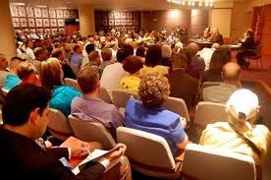

Appendix 2
PUBLIC POLICY VIEWS

Slide 41
S2-10
Taxes are necessary to pay for the common good
Notes:
S2-10
41

Slide 42
There has been some discussion in Oregon recently about the level of public services and the cost to taxpayers. Which of the following statements is closest to how you feel? (S2-5)
Notes:
S2-5
42

Slide 43
Do you believe a change is needed in Oregon’s tax system at this time?
S2-5
Notes:
S2-5
43

Slide 44
(How desirable or undesirable?)
Reduce government regulations
S3-Q23
42%
28%
Notes:
S3-Q23 It is of course interesting to see the juxtaposition of this slide with the next one, that while reduce gov. regulations is popular in concept, it does not show to be so when lowering regulations to permit more development – this certainly will not be lost on astute listeners.
44

Slide 45
S3-Q27
35%
35%
Notes:
S3-Q27
45

Slide 46
S3-Q21
Oregonians from diverse backgrounds will find common ground and work together to make progress addressing the critical issues we face as a state
Combined Very/Somewhat Responses
Notes:
S3-Q21
46

